Slide 1
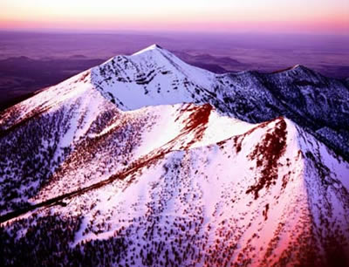


Climate-Fire Relationships in a Rare High Elevation Forest
Danielle Klaas
Mentor: Dr. Pete Fulé

Slide 2
My Study:
Apply dendrochronology (tree-ring dating) to understand forest ecology.
Reconstruct historical patterns of forest fires: severity and frequency.
  Severe fires kill entire groups of trees, after which even-aged tree groups form.
  Fire frequency determined from fire scarred trees.
Compare historical conditions to current management
Notes:
The purpose of this study is to use dendrochronolgy to reconstruct fire regimes and fire-climate relationships of bristlecone pine forests of the San Francisco Peaks. Comparing the reconstructed historical fire regime to the current management will determine how the forest burned in the past in terms of fire type (lethal/non-lethal), size, and frequency. This data will be compared to the modern fire regime and to predicted climate changes. These comparisons will help forest managers assess if the forest is sustainable or if it is at increasingly high risk for severe fire, especially as the climate warms.

Slide 3
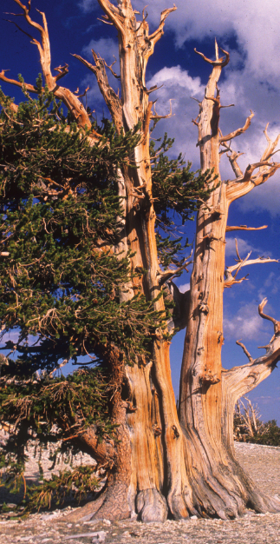
Hypotheses:
Historically fires were mixed severity
Modern management increased risk of large severe fires
Analyze:
Forest composition & structure
Fire regimes

Slide 4
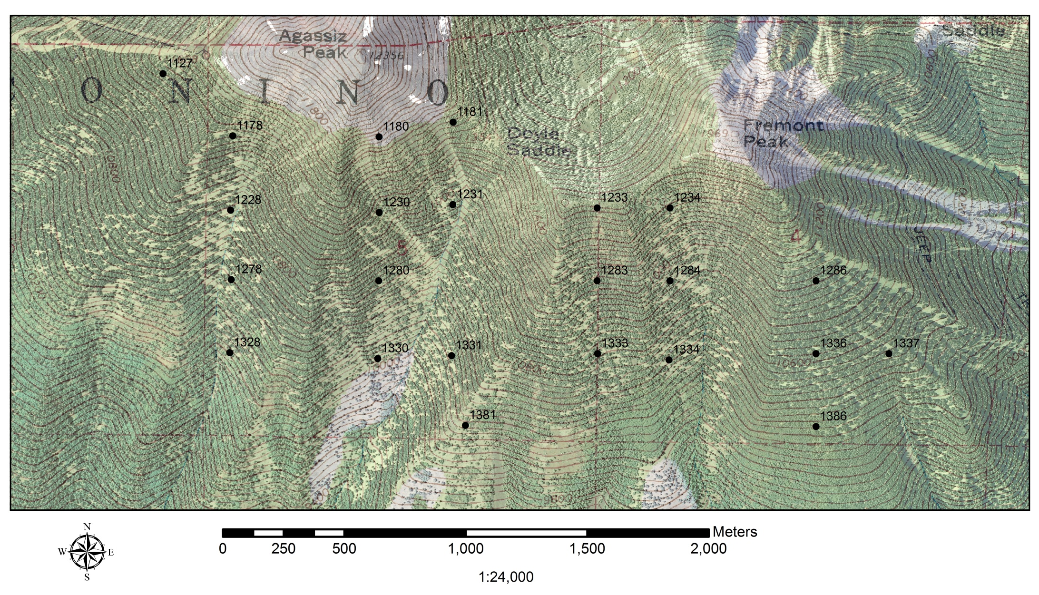
Notes:
Previously, NAU researchers Allison Cocke and Peter Fulé set up plots on the south face of the Peaks, measured forest structure and used the evidence from dendrochronological analysis of tree rings to determine what the forest was like at the time of European settlement around 1876 (Cocke et al. 2005). Twenty-three of their plots are in bristlecone pine forest; these were used as the basis of my data together with fire-scarred samples and tree age data. These plots are along aCHECK m altitudinal band. NOTE: highest forest in Az, very rare habitat type, concerns about warming climate

Slide 5
Notes:
Over whole landscape, range of ages up to about 500 years. Overall UNEVEN-AGED. No evidence of large severe disturbance wiping out entire forest at once in the last 500 yrs.

Slide 6
Even-Aged Stand
= 70% of trees are within 30 years of each other
Uneven-Aged Stand →
= 70% of trees are not within 30 years of each other

Slide 7
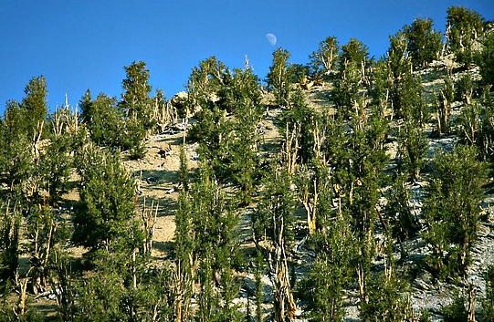
Pinus Aristata Stand Age Distribution

Slide 8
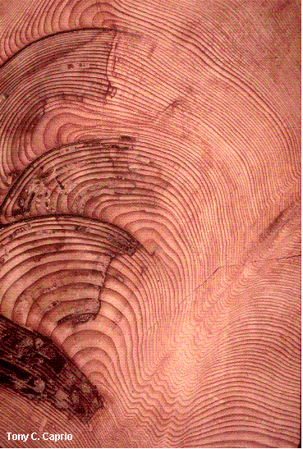
Fire Scars
Fire Years
1729
1752
1754
1773
1780
1799
1805
1834
1842
1845
1847
1867
1879
Living Snag Stump Log
23 9 2 2
Notes:
Fire scars provide evidence for frequent surface fires

Slide 9
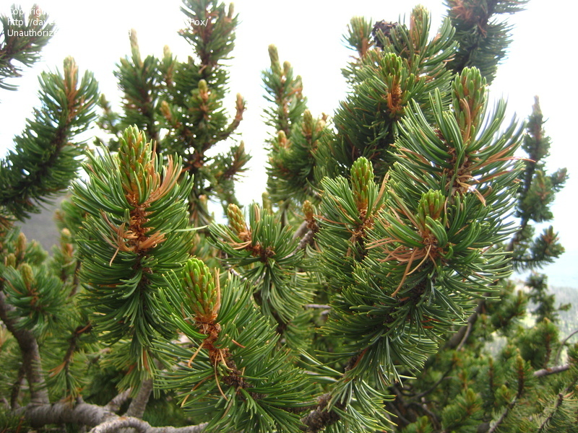
Conclusion
First Pinus aristata fire regime study in the SW
Forest structure changes
Climate warming
Risks of severe fire
Notes:
From the tree age & fire scar data we can conclude that the Bristlecone forests are overall uneven aged due to mixed severity fires in the past 500 years. Although the relationship of this data and climate change is yet to be determined, this data is useful to restore these forests to become more resilient as the climate warms. FIRST PIAR FIRE REGIME STUDY IN SW, FOREST CHANGES (COCKE DATA) = MORE CONTINUOUS FUEL (FOREST DENSITY), CLIMATE WARMING, RISK OF HIGHLY SEVERE FIRE, FOREST LOSS, RIO DE FLAG WATERSHED

Slide 10

Acknowledgements
Dr. Pete Fulé
NAU NASA Space Grant
AZ Space Consortium
NAU School of Forestry

Slide 11
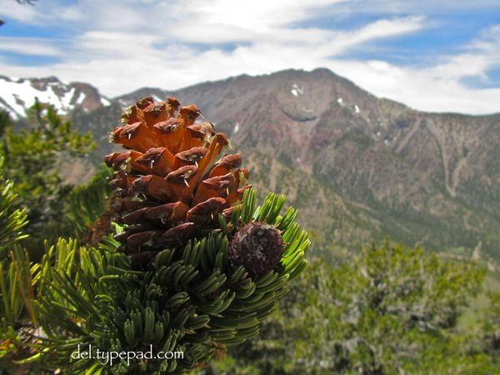
Questions

